Slide 1
FIFA World Cup
Socioeconomic Analysis
1998 – 2018 | Medallion Pipeline | Week 8 Mini-Project
Team of 4 | Python · Azure SQL Server · Pandas · Power BI
Python / Pandas
SQLAlchemy
Azure SQL
Git / Scrum
Power BI
Notes:
Welcome to our FIFA World Cup Socioeconomic Analysis project, built as a Week 8 Mini-Project by a team of four. This pipeline processes six World Cup editions from 1998 to 2018, combining Kaggle match results with World Bank economic data. The architecture follows the Medallion pattern: Bronze ingestion, Silver cleaning, and a Gold star schema loaded into Azure SQL Server, then visualized in Power BI.

Slide 2
Problem Statement & Data Sources
Business Question
01
WC Match Results
Does a country's economic profile (GDP per capita, population) correlate with its FIFA World Cup performance between 1998 and 2018?
Kaggle · evangower/fifa-world-cup
Grain: 1 match per row | 1930–2022 → filtered 1998–2018 (~384 matches)
Join key: team name + year
02
World Bank Population
worldbank.org / SP.POP.TOTL
Key Questions
Grain: 1 country × 1 year (wide format → unpivoted in Silver)
Do richer countries reach later stages on average?
Do host nations have a measurable home advantage?
Does population size predict early elimination?
Which confederations dominate performance rankings?
Join key: country_name + year
03
World Bank GDP per Capita
worldbank.org / NY.GDP.PCAP.CD
Grain: 1 country × 1 year | Current USD | Joined with pop data
Join key: country_name + year
Notes:
AMINA - Our central question is whether a country's wealth or population size correlates with its World Cup performance. We combined three data sources: the Kaggle FIFA dataset filtered to 1998-2018, and two World Bank indicators — total population and GDP per capita in current US dollars. All three sources are joined in the Gold layer on country name and year, after name standardization in Silver.

Slide 3
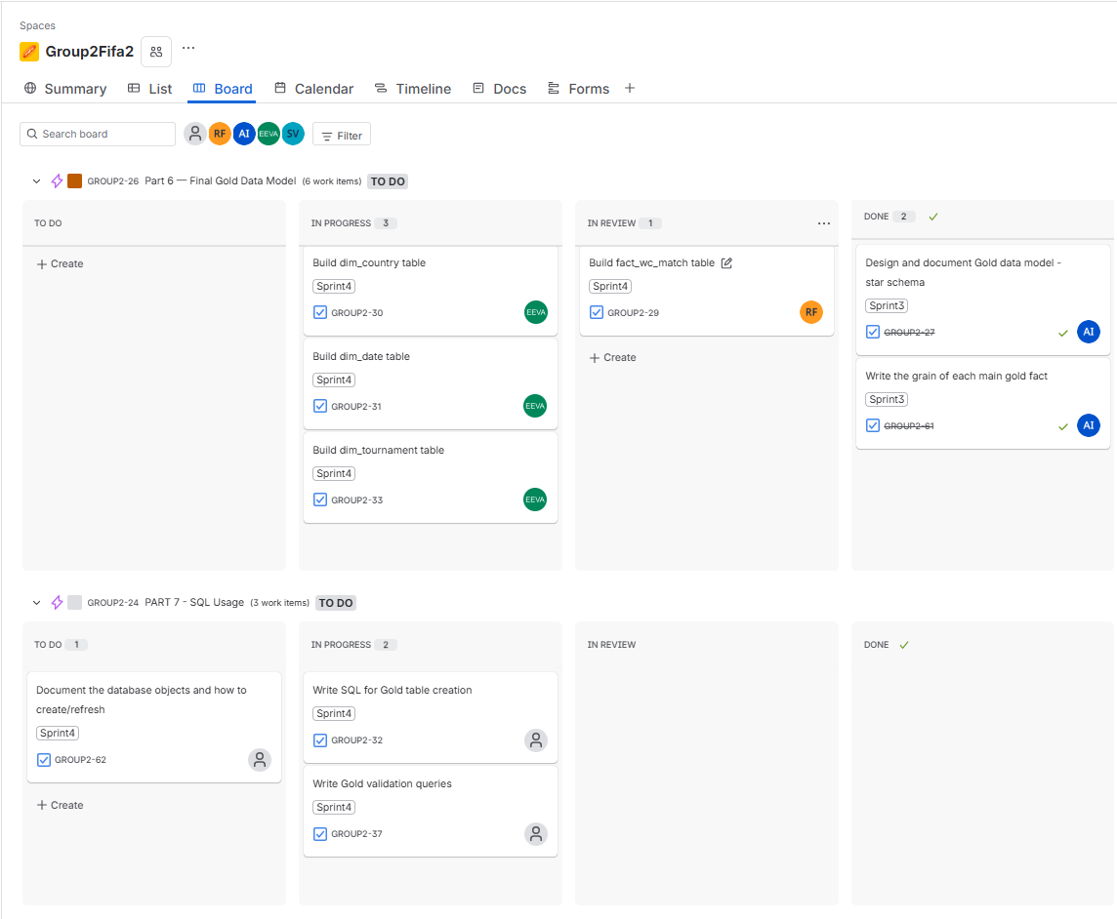
Sprint 4 — Scrum Board
Group2Fifa2 | Parts 6, 7 & 8 | Source: Jira
Work split into Jira epics (Parts 6, 7 & 8), each broken down into tasks and subtasks per pipeline stage
2 working pairs tackling different Parts simultaneously, enabling parallel progress across the sprint backlog
Daily stand-ups to sync progress, surface blockers, and reassign tasks dynamically
Clear ownership per epic to avoid overlap and maximize throughput across the sprint
Notes:
AMINA - This is our Sprint 4 board from Jira. The Gold Model epic has three dimension tables in progress by Eva, and the fact table is under review by Robin. Two SQL tasks for Gold table creation and Gold validation queries are in progress. Power BI reports remain in the backlog. The team follows Scrum with feature branches and pull requests for each task.

Slide 4
Medallion Architecture
3 sources · 3 layers · 1 integrated star schema → 768 fact rows in Azure SQL
RAW SOURCES
BRONZE
SILVER
GOLD
POWER BI
3 CSV files
bronze_*.ipynb × 3
silver_*.ipynb × 2
gold_*.ipynb · SQL SPs
Power BI Desktop
Kaggle CSV
Load CSV as-is
Filter: keep 1998–2018
Unpivot: 1 row/team/match
DirectQuery on Gold
WC results 1930–2022
skiprows=4 for World Bank
Fix 4 team name typos
Surrogate FK IDs
Page 1:
~900 match rows
Add provenance:
Melt: wide → long
performance_stars 1–6
Tournament perf.
World Bank CSVs
· source_name
country_mapping (60 entries)
is_host flag (2002 ok)
by country
Population (wide fmt)
· load_timestamp
UK split → 4 nations
Socioeconomic join
Page 2:
GDP per capita (wide)
· run_id (UUID)
ONS census pop. shares
country + year key
GDP vs. performance
270+ countries each
No transform, no filter
Quarantine invalid rows
Load → Azure SQL dbo
scatter plot
data/raw/
data/bronze/
data/silver/
fact_wc_match
2 report pages
no transform
raw + provenance metadata
384 WC rows · socioeconomics
768 rows + 3 dim tables
Gold layer only
Notes:
Our pipeline follows the Medallion Architecture pattern. Bronze ingests raw CSV files with zero transformation, only adding provenance metadata: source name, load timestamp, and a UUID run identifier. Silver cleans and standardizes the data, including a key step of splitting the UK into four nations using ONS census shares. Gold transforms everything into a star schema loaded into Azure SQL Server via SQLAlchemy. Power BI connects directly to the Gold layer for reporting.

Slide 5
Silver Layer — Python Cleaning
silver_worldcup.ipynb
silver_population_gdp.ipynb
1. Load bronze_wc_matches.csv
1. Load bronze_pop.csv + bronze_gdp.csv (skiprows=4)
2. Standardize column names (lowercase, underscore)
2. Unpivot wide→long (year columns become rows)
3. Strip whitespace from all string columns
3. Left-join Population + GDP on Country Name + year
4. Parse date → date_clean; extract year
4. Remove 15 World Bank aggregates (WLD, EUU, HIC...)
5. Filter: keep 1998–2018 only
6. Fix team name typos:
5. Filter: keep 1998–2018 only
China PR → China | FR Yugoslavia → Serbia
6. Apply country_mapping.json (60 entries, case-insensitive)
Portagul → Portugal | Columbia → Colombia
7. UK split → 4 nations (ONS census shares)
7. Flag: MISSING_YEAR, MISSING_DATE
8. Quality rules → valid + rejected files
8. Select final columns & save silver_wc_output.csv
9. Save validation_summary.txt (row count audit trail)
Output: data/silver/silver_wc_output.csv (~384 rows)
Output: valid_socioeconomics.csv | rejected/rejected_socioeconomics.csv
Notes:
Two Python notebooks handle Silver cleaning. The World Cup notebook filters to 1998-2018, fixes four team name typos (China PR to China, FR Yugoslavia to Serbia, Portagul to Portugal, Columbia to Colombia), then quarantines rows with missing date or year. The socioeconomics notebook unpivots World Bank wide format to long, applies a 60-entry country name mapping, splits the UK into four nations using ONS census shares (England 84%, Scotland 8.4%, Wales 4.7%, Northern Ireland 2.9%), then separates valid from rejected rows.

Slide 6
Data Quality & Quarantine Pattern
Quarantine Pattern
UK Nations Split
Bronze (raw)
World Bank has a single 'United Kingdom' row. Split into 4 nations using ONS census population shares (stable 1998–2018):
rejected_*.csv
Nation | Code | Pop. Share | GDP/cap
England | ENG | 84.0% | = UK value
Scotland | SCO | 8.4% | = UK value
Wales | WAL | 4.7% | = UK value
Northern Ireland | NIR | 2.9% | = UK value
Silver (quality checks)
valid_*.csv
review_reason Rules (priority order — first match wins)
Known Exclusions
P1 MISSING_COUNTRY_NAME → country_name is null
World Bank aggregates: WLD, EUU, HIC, LCN… — regional/income groups, not countries
P2 MISSING_COUNTRY_CODE → country_code is null
P3 MISSING_POPULATION → population is null
Years ≠ 1998–2018: Scoped to World Cup editions in project range
P4 MISSING_GDP → gdp_per_capita_usd is null
North Korea (DPRK): MISSING_GDP (World Bank). Only 1 WC edition (2010). 3 null rows kept in fact table — documented exclusion.
P5 INVALID_POPULATION → population < 0
P6 INVALID_GDP → gdp_per_capita_usd < 0
Notes:
SEBASTIEN - We use a quarantine pattern rather than silently dropping bad rows. Six priority rules assign a review_reason column: missing country name, missing country code, missing population, missing GDP, then negative values. The UK split is a key design decision — the World Bank reports the UK as one entity but four national teams compete separately. GDP per capita is kept identical across all four nations since it is a per-person metric unchanged by population splitting. North Korea is the only exclusion due to missing World Bank GDP data.

Slide 7
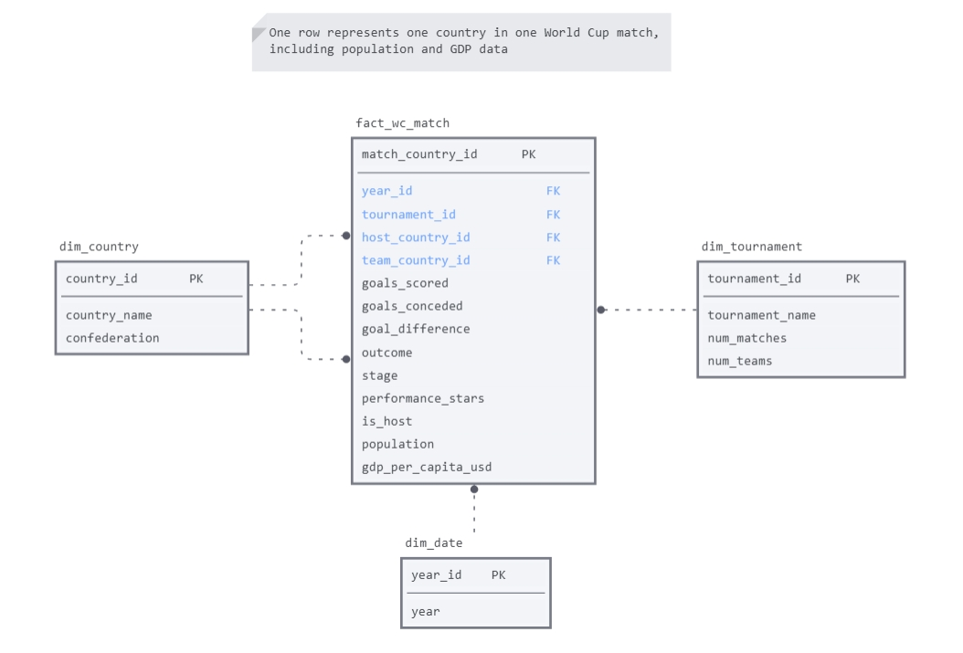
Gold Data Model — Star Schema
Grain: 1 row = 1 country × 1 match | 768 rows | Azure SQL Server, dbo schema
Notes:
The Gold layer uses a classic star schema. The fact table grain is one row per country per match, giving 768 rows across six tournaments — 384 matches times two teams. Key computed columns: performance_stars rates the furthest stage reached from one to six, and is_host correctly handles the 2002 co-hosted tournament. dim_country is a role-playing dimension used twice — once for the team country and once for the host country. North Korea has three null rows for population and GDP, a documented exclusion since the World Bank has no GDP data for them.

Slide 8
Validation — Silver & Gold
Silver Cross-Check (silver_bronze_check.ipynb)
Gold SQL Validation (sp_validate_gold_layer)
10 quality topics run after every pipeline execution:
Stored procedure — results logged to etl_golden_logs:
1. File availability — all expected files exist
1
Match + team counts per tournament vs dim_tournament
2. Row + column counts (retention %)
2
population > 0 (except North Korea)
3. Column audit — no unexpected renames
3
gdp_per_capita_usd > 0 (except North Korea)
4. Year coverage — 1998–2018 (21 years)
5. Null values — top 5 null columns per dataset
4
performance_stars between 1 and 6
6. Duplicate checks — full row + business key
5
is_host in (0, 1) — no nulls
7. Business rules (positive scores, valid dates, GDP/pop > 0)
6
All team_country_id exist in dim_country
8. Rejected row summary — breakdown by review_reason
9. Country alignment — WC teams vs socioeconomics
7
Each tournament_id maps to exactly one year_id
10. Metadata quality — source_name, load_timestamp, run_id
5 name corrections applied · 1 documented exclusion (North Korea)
PASS — 768 rows | 3 nulls North Korea (documented exclusion)
Notes:
SEBASTIEN - We ran two validation layers. The Silver cross-check notebook runs ten quality topics after every pipeline execution, surfacing issues like unexpected nulls, business key duplicates, and country name mismatches. The Gold SQL stored procedure runs seven automated checks and logs results to the etl_golden_logs table. All checks pass. The only expected anomaly is three null rows for North Korea, documented as an intentional exclusion.

Slide 9
Power BI & Next Steps
Power BI Reports
Source: dbo.fact_wc_match (Gold layer only)
Page 1
Page 2
Tournament Performance
Socioeconomic vs. Performance
Stage reached by country/year · performance_stars rankings · Host advantage · Filters by confederation and year
GDP per capita vs. performance_stars scatter · Population size vs. stage reached · Filter by confederation
If we had more time…
Incremental load · Airflow DAG · Sub-UK GDP data · 2022 WC edition
Limitations
North Korea: no World Bank GDP data (3 null rows in fact) · UK GDP per capita not split by nation · Scope 1998–2018 only (no 2022) · Power BI reports in progress
Notes:
The pipeline delivers 768 fact rows to Azure SQL Server, ready for Power BI analysis. Page one shows tournament performance by country with the performance_stars ranking and the host advantage question. Page two is a GDP versus performance scatter plot. Known limitations include North Korea missing GDP data, UK GDP not split by constituent nation, and the scope ending at 2018. Given more time, we would add incremental loading, an Apache Airflow DAG, sub-UK GDP estimates, and the 2022 World Cup data.

Slide 10
Retrospective & Lessons Learned
10
AGILE & SCRUM
GITHUB WORKFLOW
WHAT WE'D IMPROVE
FUTURE STEPS
Jira epics → tasks → subtasks
› Parts as sprint milestones
› 2 parallel working pairs
› Daily stand-ups: blockers + task reassignment
› Clear ownership per pipeline stage
Feature branch per task/subtask
› PRs created but reviews done verbally over video call + screen share rather than via GitHub's native diff view
› "Files Changed" tab rarely used: code validated visually by the reviewer watching, not by inspecting the diff
› Risk: no written trace of what was reviewed or why changes were approved
› Improvement: enforce inline comments on the diff before merge, so the review is documented and async-friendly
› Improvement: standardize naming conventions for commits
Schema validation at Bronze ingestion
› Automated transform tests (pytest)
› CI/CD pipeline for notebooks
› Centralised run logging
› Formal definition of done per task
Extend to all WC editions (1930–)
› Add HDI, inequality & education data
› ML model: predict tournament outcomes
› Real-time ingestion for live WC data
› Deploy via Azure Data Factory
Notes:
This slide reflects on the project as a whole. Agile with Jira enabled parallel progress and clear task ownership. GitHub ensured traceability and quality through peer review. Key improvements would focus on automation and data quality gates at ingestion. Future steps could extend this into a full predictive analytics platform covering all World Cup history.

